Slide 1
Encapsulation & Data Abstraction
Week 3
1
1

Slide 2
Learning Objectives
Understand encapsulation and data abstraction
Learn Python access-control conventions
Use @property getters and setters
Distinguish interface from implementation
Apply these concepts to a BankAccount example
Understand why real PIN storage needs stronger security
2
2

Slide 3
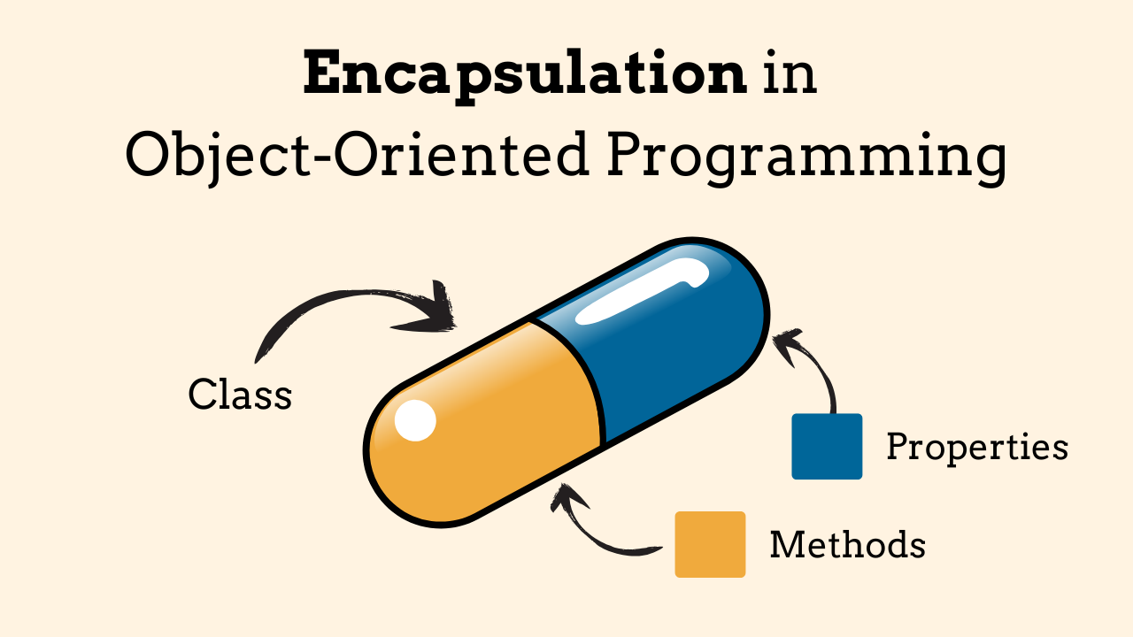
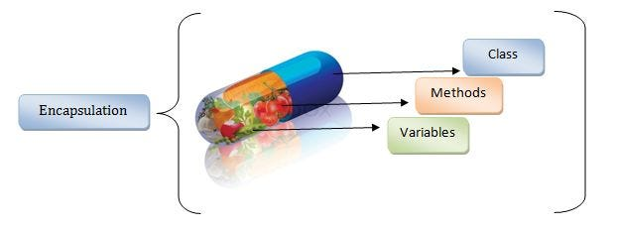
What is Encapsulation?
Encapsulation means keeping data and the methods that operate on that data together inside a class.
It also controls how outside code interacts with internal data.
Main benefits: data protection, validation, easier maintenance, and clearer class design.
3
3

Slide 4
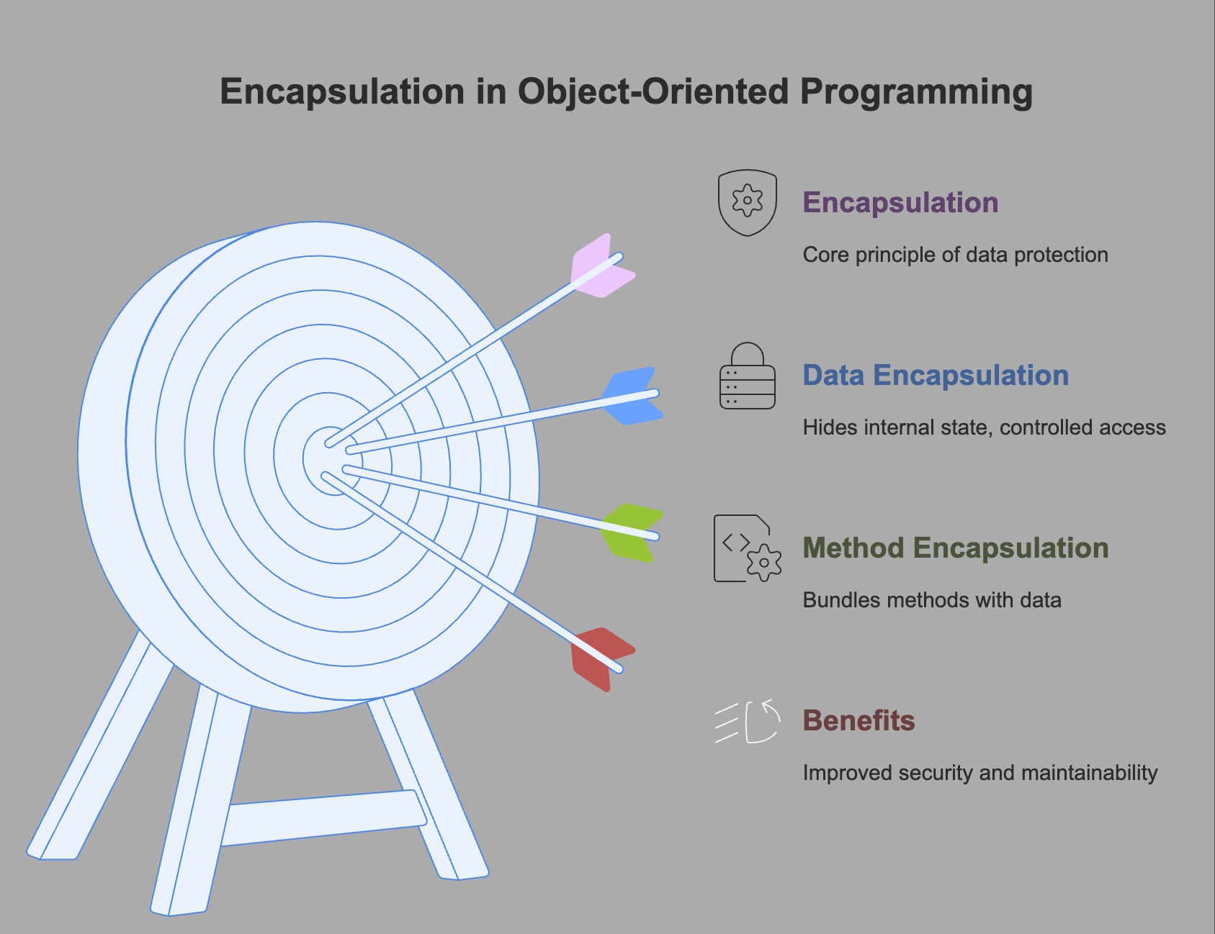
Why Encapsulation Matters
Without encapsulation, outside code could freely change important values.
For example, a bank balance should not be changed to an invalid value without checks.
Encapsulation gives the class responsibility for maintaining valid internal state.
The class exposes safe operations such as deposit() and withdraw().
4
4

Slide 5
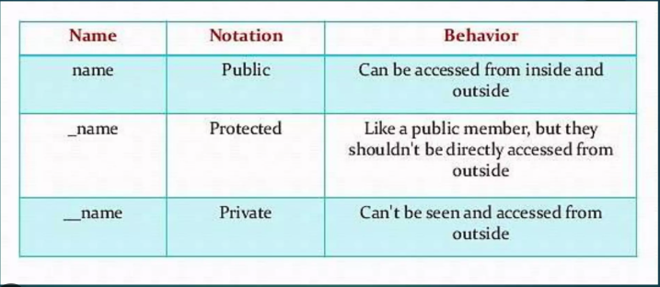
Access-Control Conventions in Python
Public: name — intended for normal outside use.
Protected convention: _name — indicates internal use; Python does not strictly enforce it.
Private-ish: __name — triggers name mangling and discourages direct access.
Important: Python's conventions are about design and communication, not absolute security barriers.
5
5

Slide 6
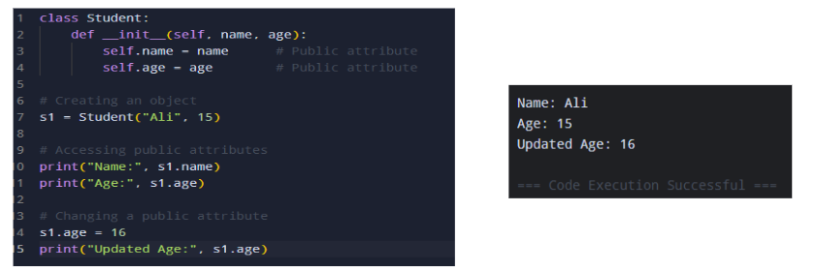
1. Public Access Modifier
Members (variables or methods) declared as public can be accessed from anywhere in the program.
By default, all members are public in Python.
6
6

Slide 7
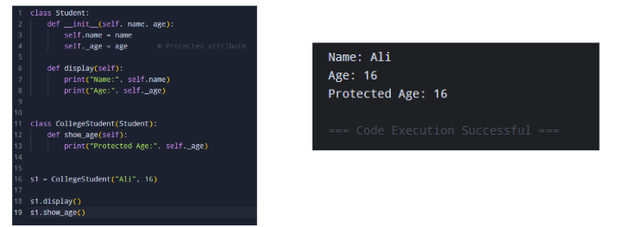
2. Protected Access Modifier
A member is considered protected if its name starts with a single underscore (_).
Convention only: It suggests that the member should not be accessed outside the class except by subclasses.
Still, Python allows direct access if explicitly called.
7
7

Slide 8
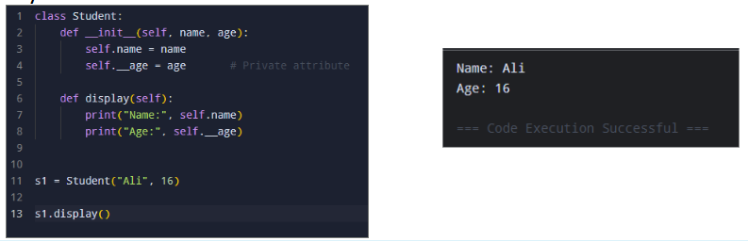
3. Private Access Modifier
A member is private if its name starts with double underscores (__).
Python does not enforce strict privacy — instead, it uses Name Mangling.
The interpreter renames __var to _ClassName__var internally.
Note: A name like __age__ (double underscores at both start and end) is not private. It is treated as a special 'dunder' name in Python and name mangling does not apply to it.
8
8

Slide 9
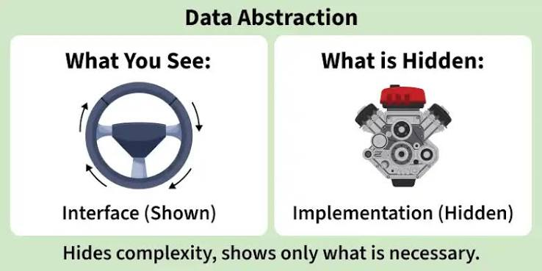
Data Abstraction
Data abstraction means hiding unnecessary implementation details and showing only the important information to the user.
In Python, abstraction can be achieved using abstract classes and the abc module.
Real Life Example: In a graphics software, multiple shapes are available such as Circle, Rectangle and Triangle. All shapes share common data and support the same set of actions, but the internal details are hidden:
Common data: name, color, border thickness, fill style.
Common actions: draw(), resize(), getArea().
Each shape implements these actions differently Circle uses radius, Rectangle uses length and width and Triangle uses base and height.
The software only knows that a shape can be drawn and its area can be calculated. How the shape is drawn or how the area is calculated is hidden.
9
9

Slide 10
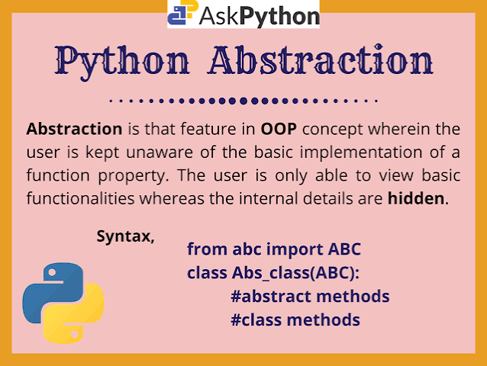
Abstract Base Class
Abstract Base Class (ABC) is used to achieve data abstraction by defining a common interface for its subclasses. It cannot be instantiated directly and serves as a blueprint for other classes.
Abstract classes are created using abc module and @abstractmethod decorator, allowing developers to enforce method implementation in subclasses while hiding complex internal logic.
from abc import ABC, abstractmethod
class Greet(ABC):
@abstractmethod
def say_hello(self):
pass # Abstract method
class English(Greet):
def say_hello(self):
return "Hello!"
g = English()
print(g.say_hello())
Explanation:
Greet is an abstract class with a method say_hello() that has no implementation.
English implements this method and returns a greeting.
This keeps structure fixed while letting subclasses define their own behavior.
Output
Hello!

Slide 11
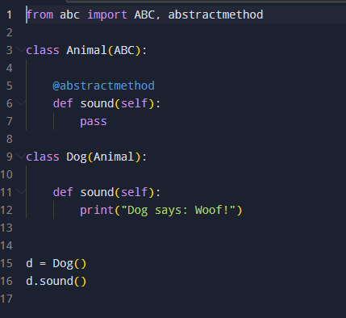

abc Module in Python
The abc module stands for Abstract Base Classes. It is used in Python to create abstract classes and abstract methods.
It helps define a common structure that child classes must follow.
Basic Syntax:
from abc import ABC, abstractmethod
class Animal(ABC):
@abstractmethod
def sound(self):
pass
Important Points
ABC → Used as the base class for an abstract class.
@abstractmethod → Declares a method that must be implemented by the child class.
You cannot normally create an object of an abstract class if it has unimplemented abstract methods.
A child class must implement the abstract methods to create its object.
In short: abc → Abstract Base Classes → used to implement abstraction in Python OOP.
9
9

Slide 12
Components of Abstraction
Abstraction is made up of key components, these elements work together to define a clear and enforced structure for subclasses while hiding unnecessary implementation details. Let's discuss them one by one.
1. Abstract Method
Abstract methods are method declarations without a body defined inside an abstract class. They act as placeholders that force subclasses to provide their own specific implementation, ensuring consistent structure across derived classes.
from abc import ABC, abstractmethod
class Animal(ABC):
@abstractmethod
def make_sound(self):
pass # Abstract method, no implementation here
Explanation: make_sound() is an abstract method in Animal class, so it doesn't have any code inside it.

Slide 13
Components of Abstraction
2. Concrete Method
Concrete methods are fully implemented methods within an abstract class. Subclasses can inherit and use them directly, promoting code reuse without needing to redefine common functionality.
Output
Moving
from abc import ABC, abstractmethod
class Animal(ABC):
@abstractmethod
def make_sound(self):
pass
def move(self):
return "Moving"
class Dog(Animal):
def make_sound(self):
return "Bark"
dog = Dog()
print(dog.move())
Explanation: move() is a concrete method defined in the abstract class Animal. Since it already has an implementation, subclasses such as Dog can use it directly without overriding it.

Slide 14
Components of Abstraction
3. Abstract Properties
Abstract properties work like abstract methods but are used for properties. These properties are declared with @property decorator and marked as abstract using @abstractmethod. Subclasses must implement these properties.
Output
Canine
from abc import ABC, abstractmethod
class Animal(ABC):
@property
@abstractmethod
def species(self):
pass # Abstract property, must be implemented by subclasses
class Dog(Animal):
@property
def species(self):
return "Canine"
# Instantiate the concrete subclass
dog = Dog()
print(dog.species)
Explanation:
species is an abstract property in Animal class and it is marked as @abstractmethod.
Dog class implements species property, making it a concrete subclass that can be instantiated.
Abstract properties enforce that a subclass provides property’s implementation.

Slide 15
Components of Abstraction
4. Abstract Class Instantiation
Abstract classes cannot be instantiated directly. This is because they contain one or more abstract methods or properties that lack implementations. Attempting to instantiate an abstract class results in a TypeError.
from abc import ABC, abstractmethod
class Animal(ABC):
@abstractmethod
def make_sound(self):
pass
animal = Animal()
Explanation:
Animal class is abstract because it has make_sound() method as an abstract method.
Instantiating Animal() raises a TypeError because abstract classes with unimplemented methods can't be instantiated, only fully implemented subclasses can.

Slide 16
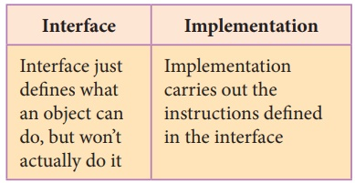
Interface vs. Implementation
Interface = what the class provides to users.
Implementation = how the class performs those operations internally.
Interface example: account.deposit(500)
Implementation example: checking the amount and updating the internal balance.
A good class can change its implementation without forcing users to change their code.
10
10

Slide 17
@property: Controlled Attribute Access
A property in Python lets you create a managed attribute in a class. It allows you to control how an attribute is read, modified, or deleted while keeping it accessible like a normal attribute.
The @property decorator is commonly used to define:
Getter — controls how an attribute is accessed.
Setter — controls how an attribute is changed.
Deleter — controls how an attribute is deleted.
Properties are useful for:
Validation: reject invalid values.
Consistency: keep object state valid.
Flexibility: change internal storage without changing the public interface.
Read-only properties can expose information without allowing direct modification.
11
11

Slide 18
Getters with @property
A getter reads an internal value.
Example:
class Student:
def __init__(self, age):
self._age = age
@property
def age(self):
return self._age
12
12

Slide 19
Setters with @property
A setter controls how an attribute is changed.
It is useful for validation.
Example:
@age.setter
def age(self, value):
if value >= 0:
self._age = value
else:
raise ValueError('Age cannot be negative')
13
13

Slide 20
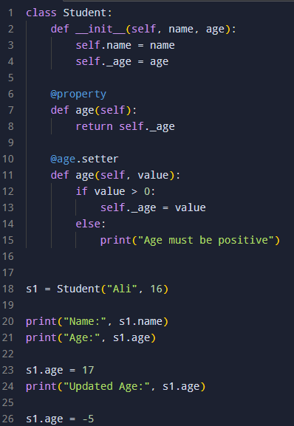
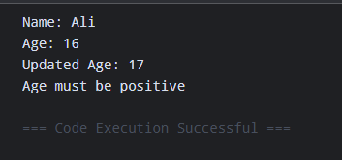
Setters with @property
@property allows us to read _age using s1.age.
@age.setter allows us to control changes to the age.
If someone tries to set an invalid age, the setter can reject it.
This provides controlled access to attributes.
13
13

Slide 21
Deleter with @property
class Person:
def __init__(self, age):
self._age = age
@property
def age(self):
return self._age
@age.setter
def age(self, value):
if value < 0:
raise ValueError("Age cannot be negative")
self._age = value
@age.deleter
def age(self):
print("Deleting age")
del self._age
14
14

Slide 22
Why Use Getters and Setters?
Validation: reject invalid values.
Consistency: keep object state valid.
Flexibility: change internal storage without changing the public interface.
Read-only properties can expose information without allowing direct modification.
14
14

Slide 23
BankAccount: Applying Encapsulation
A bank account is a useful example because balance and authentication information should be controlled.
Internal data: __balance and __pin
Public operations: deposit(), withdraw(), verify_pin()
Read-only public property: balance
15
15

Slide 24
BankAccount — Class Structure
class BankAccount:
def __init__(self, balance, pin):
self.__balance = balance
self.__pin = pin
@property
def balance(self):
return self.__balance
16
16

Slide 25
BankAccount — PIN Verification
def verify_pin(self, pin):
return pin == self.__pin
Keeping PIN checking inside the class means outside code does not need direct access to the stored value.
The class controls the authentication-related operation.
17
17

Slide 26
BankAccount — Deposit
def deposit(self, amount):
if amount > 0:
self.__balance += amount
else:
print('Invalid amount')
The method protects the object's state by rejecting invalid deposits.
18
18

Slide 27
BankAccount — Withdrawal
def withdraw(self, amount, pin):
if not self.verify_pin(pin):
print('Incorrect PIN.')
return
if 0 < amount <= self.__balance:
self.__balance -= amount
else:
print('Invalid withdrawal amount')
19
19

Slide 28
Using the Class
account = BankAccount(1000, '1234')
print(account.balance)
account.deposit(500)
account.withdraw(200, '1234')
print(account.balance)
Users interact through the class interface instead of changing __balance directly.
20
20

Slide 29
Encapsulation + Abstraction Together
Encapsulation protects and organizes internal state.
Abstraction presents a simple interface to the user.
Properties provide controlled attribute access.
Methods provide controlled operations.
Together, these principles create classes that are easier to use, test, and maintain.
21
21

Slide 30
Important Security Limitation
The example is for learning OOP concepts, not real banking security.
Storing a PIN directly as a Python string is not appropriate for a real system.
Real applications should use secure authentication design, protected storage, rate limiting, and appropriate cryptographic hashing for PIN/password verification.
Private attributes such as __pin do not make sensitive information cryptographically secure.
22
22

Slide 31
Common Mistakes
Assuming __name is impossible to access.
Using protected/private naming as if it were encryption.
Allowing direct modification of important state.
Forgetting validation in setters and methods.
Putting too much implementation detail into the public interface.
Storing real credentials in plain text.
23
23

Slide 32
Key Takeaways
Encapsulation controls access to object data.
Python uses naming conventions: public, _protected, and __private-ish.
@property provides controlled getter/setter behavior.
Abstraction hides implementation details.
An interface describes what users can do; implementation describes how it works.
Sensitive data requires real security measures beyond Python access conventions.
24
24

Slide 33
Quick Review
1. What is encapsulation?
2. What does a leading underscore mean in Python?
3. What does @property do?
4. What is the difference between interface and implementation?
5. Why is __pin not enough to secure a real PIN?
6. Why should balance changes happen through methods?
25
25

Slide 34
Python Program 1 — Basic Encapsulation
The balance is stored internally and changed through a method.
class BankAccount: def __init__(self, balance): self.__balance = balance def deposit(self, amount): if amount > 0: self.__balance += amount def get_balance(self): return self.__balance account = BankAccount(1000) account.deposit(500) print("Balance:", account.get_balance())
27

Slide 35
Python Program 2 — @property Getter
The @property decorator lets us read age using student.age instead of calling a getter method.
class Student: def __init__(self, age): self._age = age @property def age(self): return self._age student = Student(16) print("Age:", student.age)
28

Slide 36
Python Program 3 — @property Getter + Setter
The setter validates data before allowing the internal value to change.
class Student: def __init__(self, age): self._age = age @property def age(self): return self._age @age.setter def age(self, value): if value >= 0: self._age = value else: print("Age cannot be negative.") student = Student(16) student.age = 17 print(student.age) student.age = -5
29

Slide 37
Python Program 4 — Interface vs. Implementation
deposit() and get_balance() are part of the interface; the internal balance update is implementation.
class BankAccount: def __init__(self, balance): self.__balance = balance # Public interface def deposit(self, amount): if amount > 0: self.__balance += amount # Public interface def get_balance(self): return self.__balance account = BankAccount(1000) # The user only needs to know the interface: account.deposit(250) print(account.get_balance())
30

Slide 38
Python Program 5 — Bank Account with PIN
This combines private attributes, a read-only property, validation, and controlled methods.
class BankAccount: def __init__(self, balance, pin): self.__balance = balance self.__pin = pin @property def balance(self): return self.__balance def verify_pin(self, pin): return pin == self.__pin def deposit(self, amount): if amount > 0: self.__balance += amount def withdraw(self, amount, pin): if not self.verify_pin(pin): print("Incorrect PIN.") return if 0 < amount <= self.__balance: self.__balance -= amount print("Withdrawal successful.") else: print("Invalid withdrawal amount.") account = BankAccount(1000, "1234") print("Balance:", account.balance) account.deposit(500) account.withdraw(200, "1234") print("Balance:", account.balance)
31

Slide 39
Python Program 6 — Menu-Based Bank Account
This is a compact practical program suitable for a classroom demonstration.
class BankAccount: def __init__(self, balance, pin): self.__balance = balance self.__pin = pin @property def balance(self): return self.__balance def check_pin(self, pin): return pin == self.__pin def deposit(self, amount): if amount > 0: self.__balance += amount return True return False def withdraw(self, amount, pin): if not self.check_pin(pin): return "Incorrect PIN" if amount <= 0 or amount > self.__balance: return "Invalid amount" self.__balance -= amount return "Withdrawal successful" account = BankAccount(2000, "2468") print("Current balance:", account.balance) print(account.deposit(300)) print(account.withdraw(500, "2468")) print("Final balance:", account.balance)
32

Slide 40
Tasks
1. Create a Person class with a protected _age attribute and a method that displays the age.
2. Create a Rectangle class with private __length and __width attributes. Add a method to calculate area.
3. Create a Student class with an @property getter for marks.
4. Add a setter to Student.marks that rejects marks below 0 or above 100.
5. Explain in your own words the difference between encapsulation and abstraction.
33

Slide 41
Tasks
1. Create a BankAccount class with private __balance. Implement deposit() and withdraw().
2. Add a read-only @property called balance.
3. Modify withdraw() so that a withdrawal cannot exceed the current balance.
4. Add a private-ish __pin and a verify_pin() method.
5. Allow withdrawal only when the correct PIN is supplied.
6. Explain which parts of your BankAccount class form the public interface.
34

Slide 42
Tasks
1. Build a complete ATM-style BankAccount program using encapsulation.
2. Include deposit, withdrawal, balance checking, and PIN verification.
3. Use @property for balance and at least one setter for validated data.
4. Add clear error messages for invalid amounts and incorrect PINs.
5. Do not allow direct modification of __balance through the normal class interface.
6. Bonus: add a transaction history list and a method that displays recent transactions.
35

Slide 43
Questions
1. Why is __balance preferable to a public balance attribute in this example?
2. Is a double underscore the same thing as encryption? Explain.
3. What is the purpose of @property?
4. When would a setter be useful?
5. What is the difference between an interface and an implementation?
6. How does abstraction make a class easier to use?
7. Why should real applications not store PINs as plain-text strings?
36

Slide 44
Final Tasks
1. Design a SecureBank class using encapsulation and data abstraction.
2. Requirements: private balance, controlled deposit and withdrawal, PIN verification, @property balance getter, input validation, and a clear public interface.
3. Submit: Python source code, sample output, and a short explanation of where encapsulation and abstraction are used.
4. Extension: describe at least two ways a real banking application would improve security beyond Python's private naming convention.
37

